Slide 1
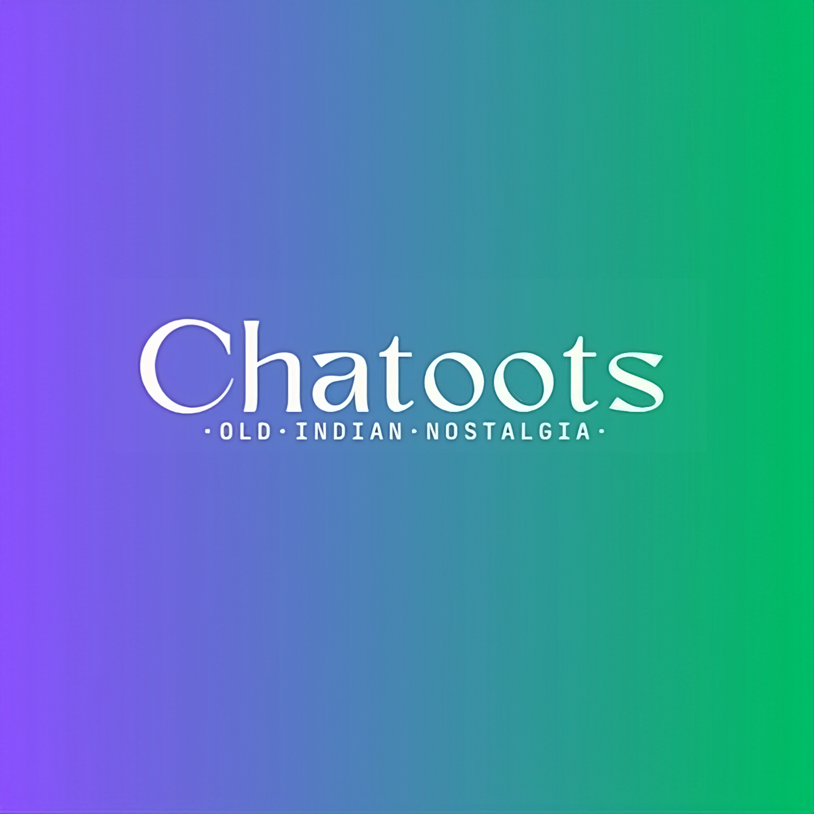
A Journey
Of Flavours
Across Borders

Slide 2
Why we started this business?
We found a gap between the Indian eatables and overseas Indians. Overseas Indians lost the taste of their origin, but our competitors provide but on high value and the middle-class Overseas Indians can’t afford it. So, for filling the gap we started our company ‘’Chatoots’’

Slide 3
Flavourful foundation of chatoots
Growing Demand:- There is growing demand of flavorful Indian eatables, domestically and internationally. With more people looking for authentic taste experiences, your Products could fill a niche in the market. The amount size of Indian eatables industry worldwide is around $15.61 billion in 2024. The market is expected to grow annually by 8.19% (CAGR 2024-2028) .
Unique offering:- By focusing on Indian packed eatables, we are offering something distinctive that may not widely available in the market. This uniqueness will help our brand to standout and attract customer looking for Indian flavors.
Cultural Connections:- Food has a way of connecting people to their roots. By providing packed eatables. We are offering a taste of home for many people who may be living far from India or who simply appreciate Indian eatables
scalability:- The snack industry offers opportunities for scalability, allowing you to start small and expand your product line as your business grows. You could eventually branch out into different types of eatables or even other food categories.

Slide 4
Market holding of our Competitors

Slide 5
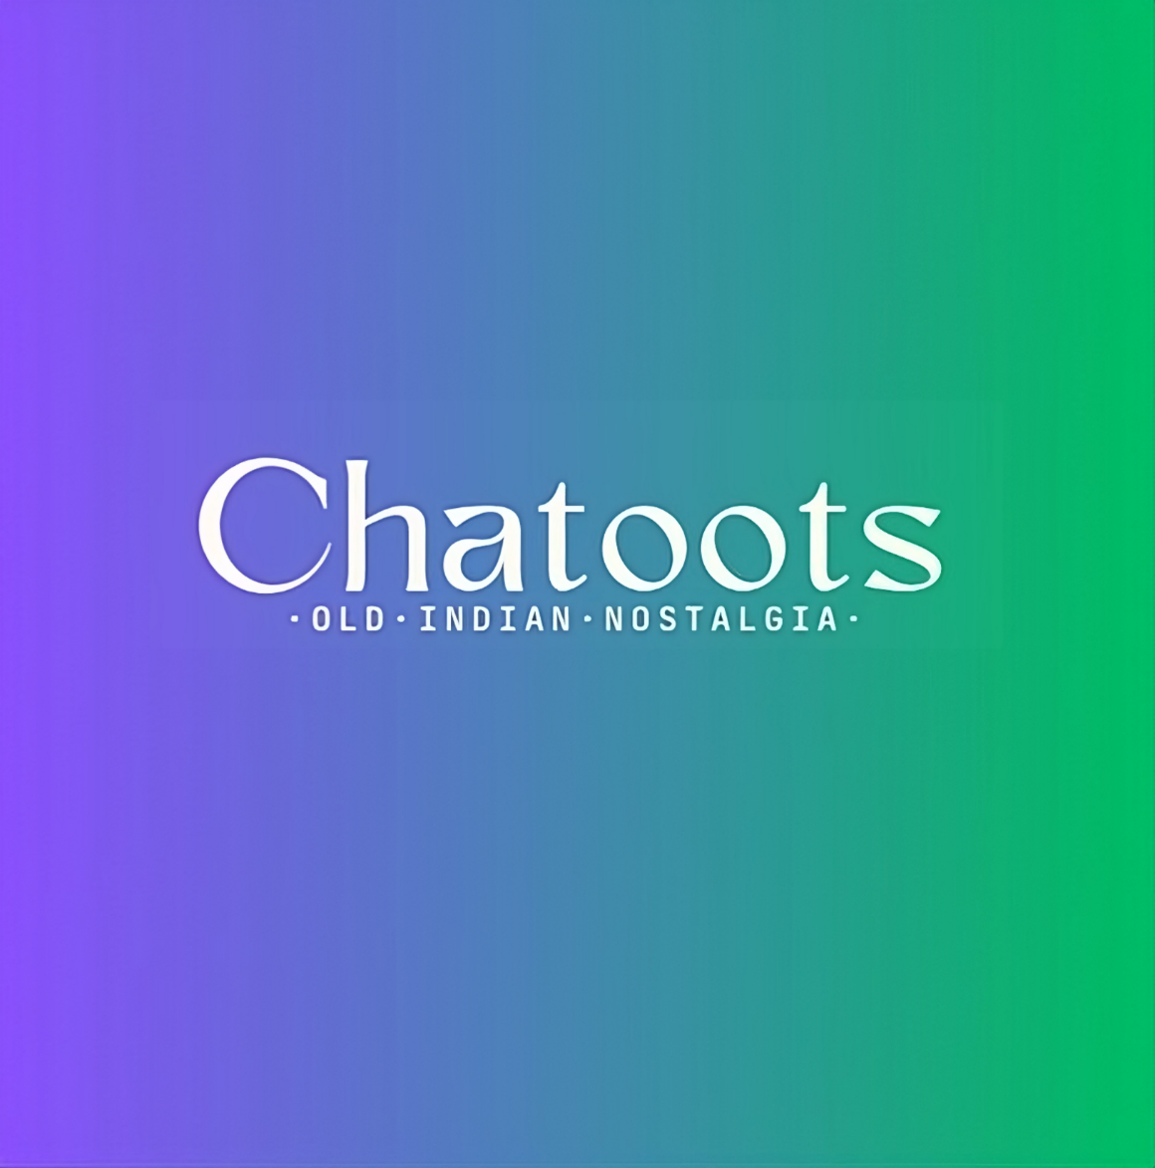
Business Model
Our motive is to provide overseas Indians the taste of their origin which are vanished from their taste buds and minds. The people who are willing to get the kick back from the Indian taste. We deliver these eatables to their Doorstep in overseas countries in 12 -17 days in 5 business hours. We deliver eatables Such as:- Imli candy, orange candy, chatmola, Hing(asafoetida) Candy, mango papad, etc.

Slide 6
Customization and Personalization:
We offer our Customers to personalize their order by:-
Customized Product Bundles
Build-Your-Own-Box Options
Seasonal and Holiday Offerings
Family and Group Ordering
Surprise and Delight Initiatives

Slide 7
Financial Projections:
According to give graph
Market sell Arora lemon at the price of 10 rupees pre unit. We sold it at 9 rupee per unit
In the market aam papad sold ate ther rate of 5 rupee per unt but we sold at 4
At last, Imli Candy sold 10 rupee per packet, and we sell 7 rupee per packet

Slide 8

Our profit margin
According to the financial Projection, our Difference between the cost price and selling price is less than other competitors. It is the secondary reason we can stand out from the crowd and will be highlighted

Slide 9
Our Operation expenses

Slide 10
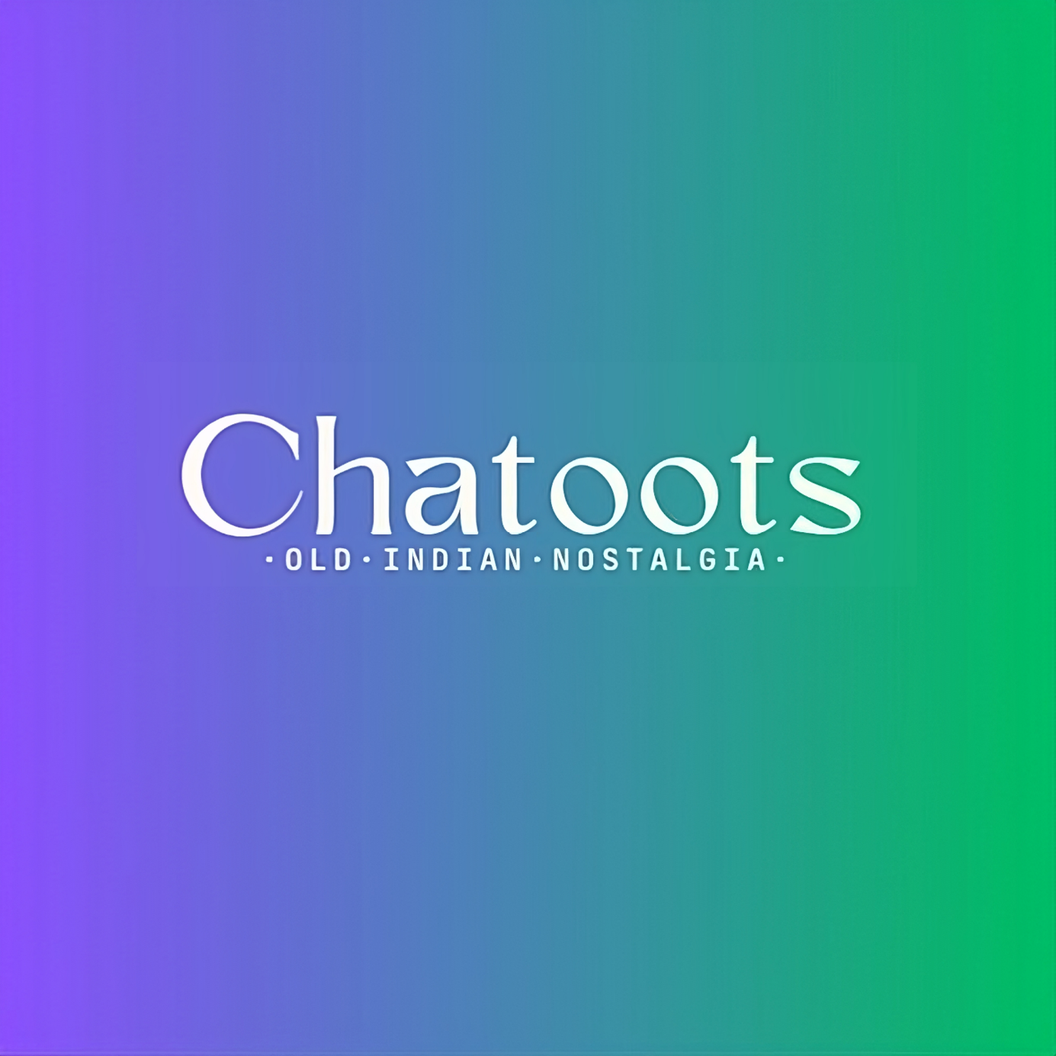
Thank You
Empowering Overseas Indians Through the Nostalgia
Email: Chatootsoff@gmail.com
Website:
Thank you

